Slide 1
REAL-TIME HUMAN DETECTION & COUNTING

Slide 2
INTRODUCTION
A real life application of human object detection model.
Use of Image Processing, Video Processing, Object Detection and Deep neural networks are used which are rigorous parts of modern Artificial Intelligence.
The project will focus on human object detection and count of people in an image or in a real time video through camera or some other source.
We’ve worked on three different methods and algorithms to detect a human object in order of their increasing accuracy.

Slide 3
Real-Time Counting People In Python: Project Details and Technology
Project Name: Real-Time Human Detection & Counting in Python
Language/s Used: Python Deep Learning
Python version: 3.8/3.9
Database: None
Type: Desktop Application
Updates: 0

Slide 4
About the project
This 2022 Real-Time Counting People OpenCV Python project was created with Python OpenCV. In this python project, we will build a Human Detection and Counting System utilizing a Webcam or your own video or photos.
A Counting People OpenCV Python project is an intermediate level deep learning project on computer vision that will help you grasp the principles and become a Data Science specialist. The Python project necessitates a basic understanding of Python programming and the OpenCV library.

Slide 5
Real-Time Counting People In Python:
The people counting camera counts the number of people who arrive, leave, or pass through a defined region. It generates reports for study on a daily, weekly, monthly, and annual basis. The people counting camera has improved anti-interference technology and is simple to set up.
1) Detection & Counting through Image
This section works with real time images. Here will allow user to select any real time image from the local system and then user can detect the humans in it. And along with that it also gives the count of humans detected.

Slide 6
Real-Time Counting People In Python:
2) Detection & Counting through Video
This section works with real time videos. Here will allow user to select any real time video from the local system and then user can detect the humans in it.
Now in case of video, since it is running, while the detection process is going on user will be able to see the detected peoples and their count for each frames per second of the video.
3) Detection & Counting through Camera
This section works somehow similar to case of video. Here user will be asked to first open the webcam, and it will detect humans that will comes in that webcam during the detection process.

Slide 7
FURTHER IMPROVEMENT
Further we have improved some user interfaces and added some additional features.
Used additional libraries like
Imutils - a series of convenience functions to make basic image processing functions such as translation, rotation, resizing, skeletonization, and displaying Matplotlib images easier with OpenCV and Python.
Argparse – this module makes it easy to write user-friendly command-line interfaces.
Also worked on the labelling of the human body detected by the program by the counter which tells us the count of the number of people at that particular instance in the video.

Slide 8
OpenCV
OpenCV is a huge open-source library for computer vision, machine learning, and image processing. OpenCV supports a wide variety of programming languages like Python, C++, Java, etc.
It can process images and videos to identify objects, faces, or even the handwriting of a human. When it is integrated with various libraries, such as Numpy which is a highly optimized library for numerical operations, then the number of weapons increases in your Arsenal i.e whatever operations one can do in Numpy can be combined with OpenCV.
This OpenCV tutorial will help you learn the Image-processing from Basics to Advance, like operations on Images, Videos using a huge set of Opencv-programs and projects.

Slide 9
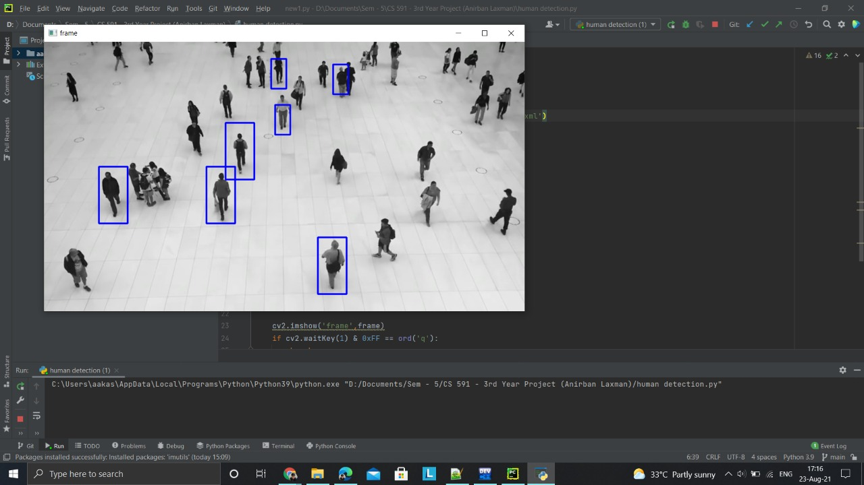
SAMPLE OUTPUT

Slide 10
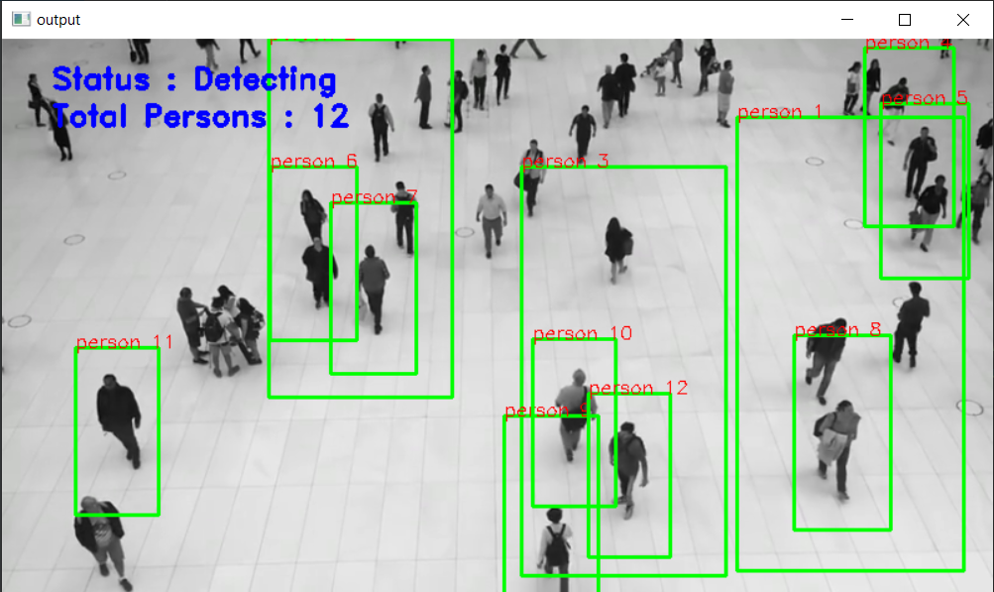
FURTHER IMPROVEMENT
Executed the program and got the output as below with more accuracy on numbers detected and got the labelling also.

Slide 11
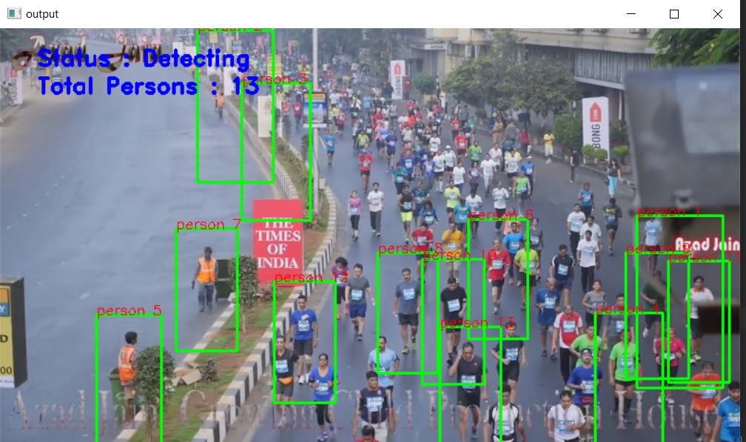
SAMPLE OUTPUT

Slide 12
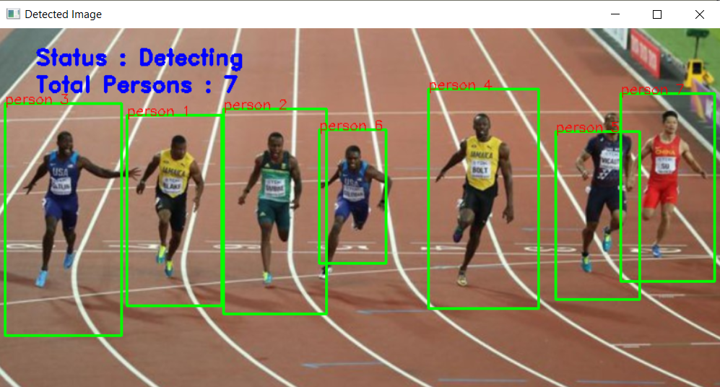
DETECTION IN AN IMAGE
In the same way when we select video from the local system, it will give the output by detecting the humans in the video.

Slide 13
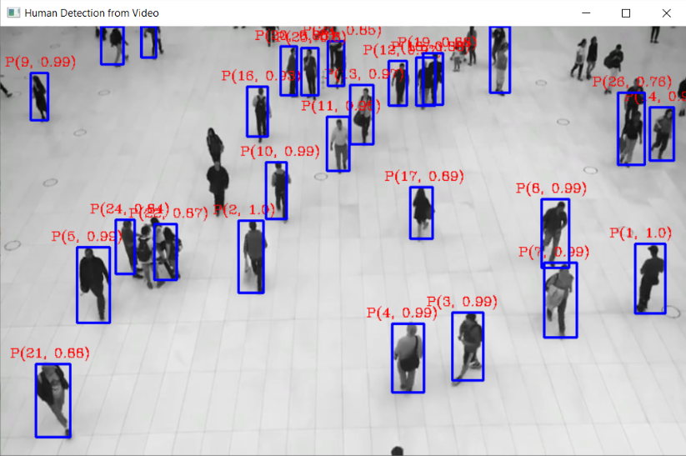
SAMPLE OUTPUT
The sample screenshot accuracy increased with tensorflow is as follows:
Here for each detected human, the first term is count and the second term is the accuracy of detection.

Slide 14
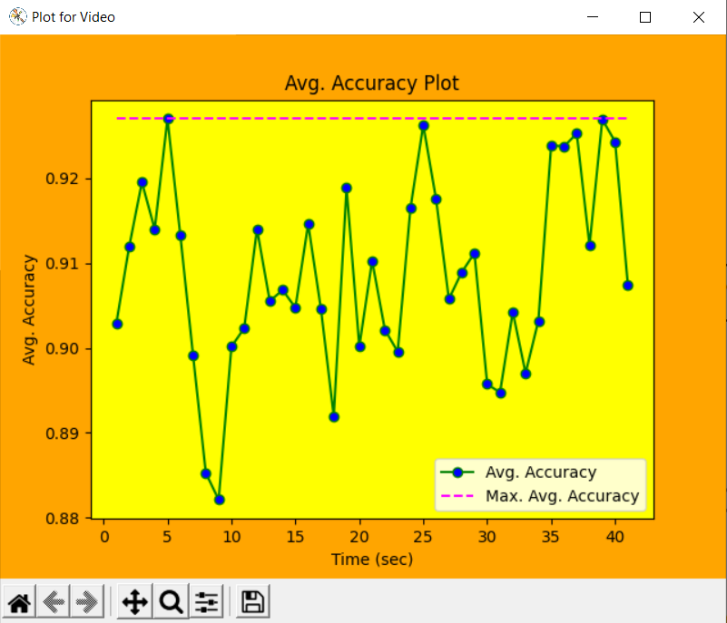
GRAPH PLOTTING
After detection and counting process, we plotted the following plot using the data collected.
Avg. Accuracy plot :

Slide 15
CONCLUSION
Conclusively, the project was a real fun throughout the semester. We have learned a lot in the field of computer vision and object detection techniques.
this can be implemented in the commercial and rushed areas for having an accurate human data and for controlling the crowd.

Slide 16
THANK YOU

